Slide 2
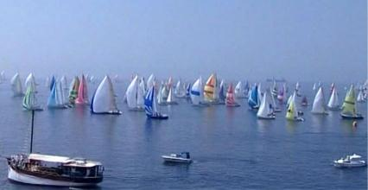
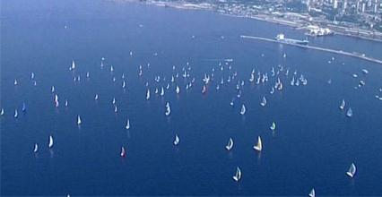
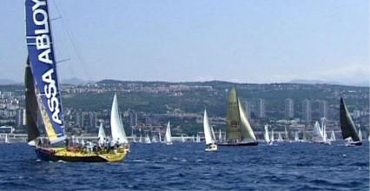
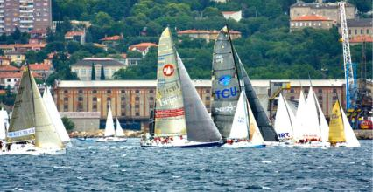
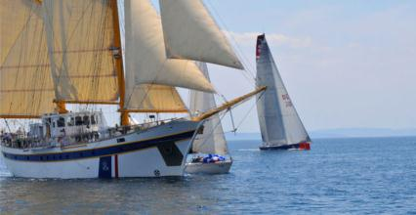
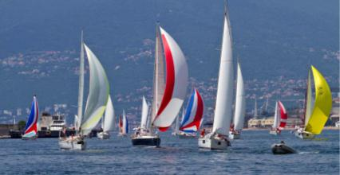
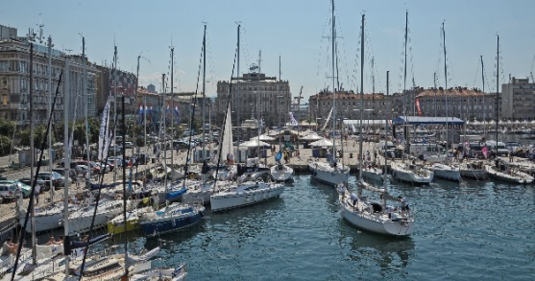
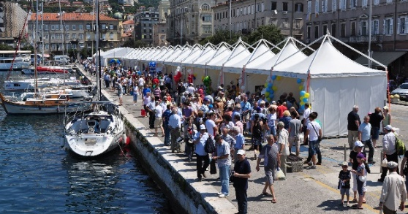
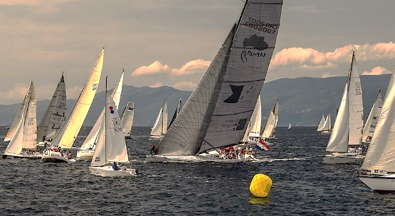
TOP SAILING EVENT!

Slide 3
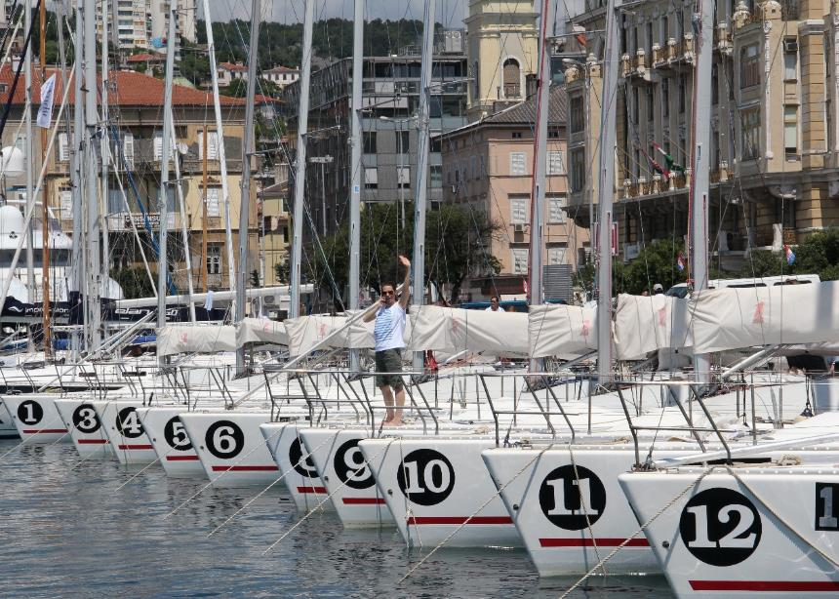
FIUMANKA 2014 IN NUMBERS
• 170 boats from 12 countries
• 5 different races within Fiumanka
• More than 2,000 participants
• More than 20,000 spectators
A main feature that distinguishes Fiumanka from other top sailing events is that it is free for all participants

Slide 4
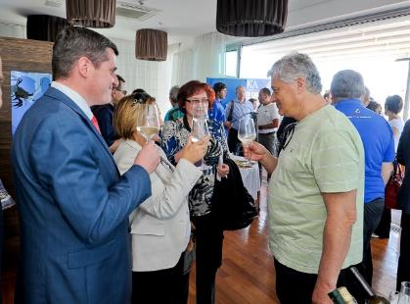
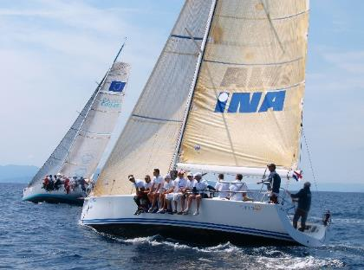
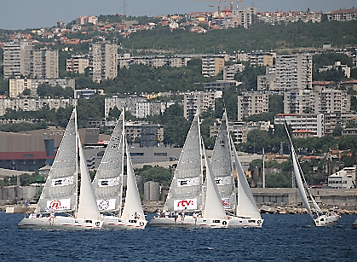
FIUMANKA IS A UNIQUE EVENT WITH GREAT FLAIR IN WHICH PARTICIPANTS FIND PURE ENJOYMENT
businessmen do business in a relaxed way
politicians and businessmen enjoy sailing
media find pleasure in outplaying one another

Slide 5
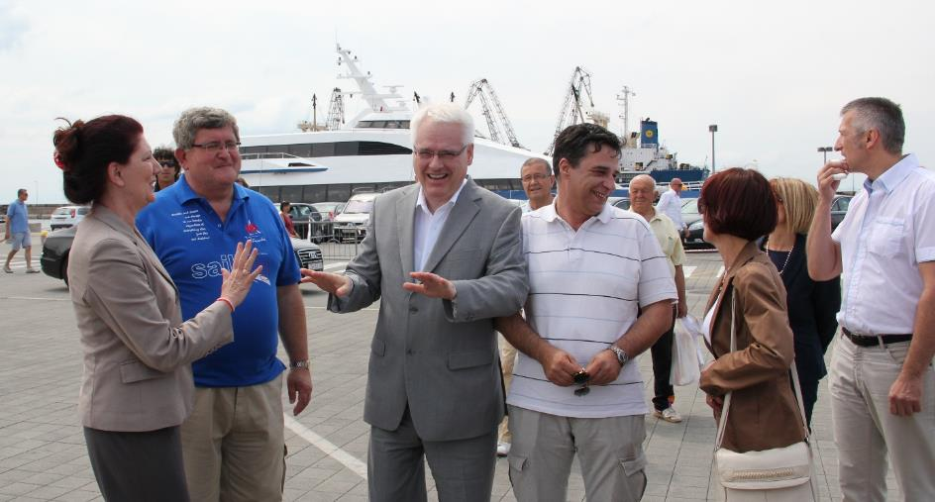
PATRONAGES
For the sixth year in a row, the Fiumanka is held under the patronage of the Croatian President Dr. Ivo Josipović
Fiumanka is also held under the patronage of City of Rijeka, Primorsko-goranska County, City of Rijeka Tourist Board
and Rijeka Port Authority.

Slide 6
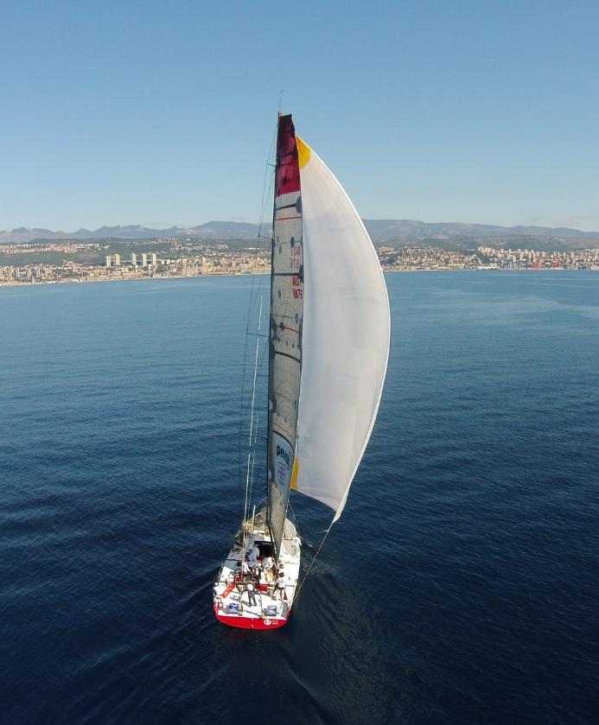
2015 FIUMANKA PROGRAMME SAILING SHOW Fiumanka ( Sailing Fair) 10 - 12 June LIBURNIAN REGATTA (Navigation regatta via ancient maritime routes of Liburnia) 10 - 11 June EMSR (European Media Sailing Race) 11 - 12 June ROTARY Fiumanka (Charity Regatta of the Rotary Club of Rijeka) 10 - 11 June FIUMANKA (the traditional final race) 12 June

